Slide 1
Southwest Corridor Study
Kick-Off Meeting
October 25, 2018

Slide 2
Stakeholders & Study Team
Monroe County
City of Bloomington
BMCMPO
Bloomington Chamber of Commerce
INDOT
American Structurepoint
Tom Vandenberg
Patrick Wooden

Slide 3
Study Purposes
Improve Mobility
Congestion Relief
Greater Traffic Circulation
Accessibility & Connectivity

Slide 4
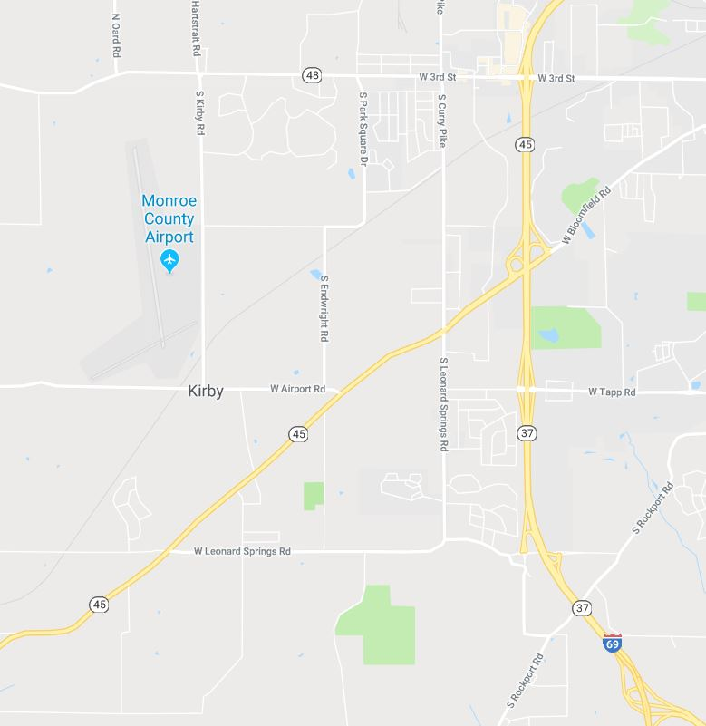
Study Area
Currently Experiencing Congestion
Legend
Roadway Extension =
Study Intersection =

Slide 5
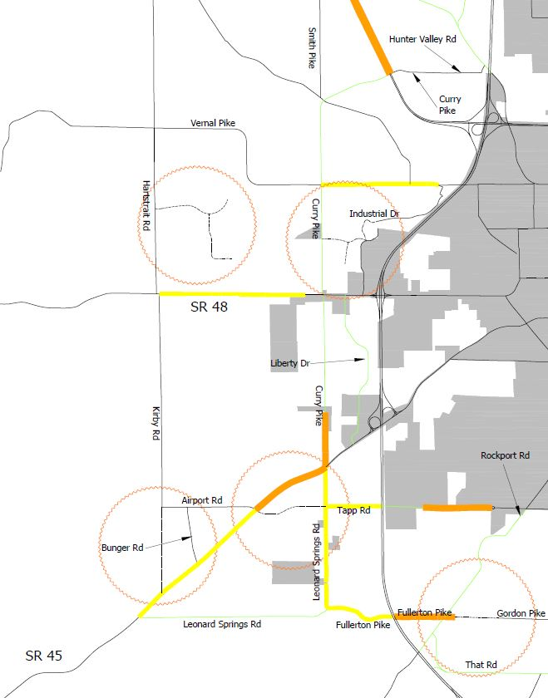
Thoroughfare Plan

Slide 6
Schedule
Task | Oct | Nov | Dec | Jan | Feb | Mar | April
Kick-Off Meeting
Data Collection
Existing Condition Analysis
Public Meeting
Future Condition Analysis
Public Meeting
Corridor Study Preliminary Report
Corridor Study Final Report

Slide 7
Tom Vandenberg
American Structurepoint, Inc.
317-419-1263
tvandenberg@structurepoint.com

