Slide 1
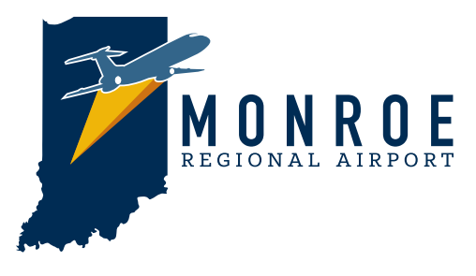
Valerie PeÑa Consulting LLC
2021

Slide 2
Business Owners
Aviation Specialists
Athletics
14
Developers
Commercial Real Estate
Community Leader Groups
3
total
participants
individual interviews
4
15
13
focus groups
questions
hours of discussion
Focus Groups

Slide 3
Engagement
What do you know?
How do you feel?
Recommendation
Name
Logo
Ways to move forward
Exploration
Are ideas believable?
Are goals obtainable?
What are the hindrances?
Focus Group Questions

Slide 4
When you hear Monroe County Airport what comes to mind?
Small county airport
Private
Small planes only
Little planes
Can’t fly from there
Event space – entertainment
Great potential for infrastructure
Small airport with a big runway
Two FBOs
Underutilized
Lots of aircraft – who owns all those planes??
Commercial service that isn’t coming back
1000s of acres but no development
Didn’t even know we had one until I went to the county fair
Didn’t know until I got this job and took a tour of BMG
Need to be rich
Perception is rich man’s playground
City Sewer available
Fire Station
Responses

Slide 5
Do you feel you are familiar with the airport and its services? If so, can you name any?
Regional travel is possible
A towered airport offers versatility
Surprised on how much hanger space there was
BMG Center is amazing – best facility in all of Indiana
Provide cars
Security is fantastic
Maintenance facilities are great
Barbershop is out there – weird at first but I kinda like it
Fixed based operation
Control towner – I’d like to go up there some time
BMG
Some private hangers – “Commercial” non aviation activity
Ivy Tech’s auto class is there
They keep buying land
No catering available
Know Crane and Cook use it – IU does too…I think
I know there’s something about “inside or outside” the fence
They are well known for their safety
Service level is good but it’s not full service
I’ve been to some entertainment things there – kinda cool
Since it lost commercial – the general public is not exposed and doesn’t understand because they don’t see it
Responses

Slide 6
Any wish list items they missed?
Time, energy & money
Infrastructure pictures
Leading edge technology
Funky zoning – RE1 – scattered industrial – no general commercial
Get a good description of AP zoning and what is allowed
Responses

Slide 7
Vision statement – To be the regional hub for aviation business activity, economic growth, and a gateway to southern Indiana’s infrastructural future.
Is it obtainable?
No doubt it’s a hidden secret unless you are in the aviation world
Strike southern Indiana – think bigger
Important areas for vision are life sciences, defense, manufacturing
Not sure what “infrastructural future” means
add “transportation infrastructure”
Issue is access
“Community” isn’t in the vision statement – if they want to connect, they should include
It’s aspirational – I like it – but it sure isn’t how they are perceived now
It’s pretty lofty – maybe too lofty
Infrastructural future is too broad – airport is not going to impact infrastructure
They should put warehouses there
Responses

Slide 8
Vision statement – To be the regional hub for aviation business activity, economic growth, and a gateway to southern Indiana’s infrastructural future.
What would the airport need to do to get there?
We need transportation
Think bigger
Don’t forget the Uplands
Flight school
Not enough to get me to put my plane there
General public is clueless on the services out there
Flight service takes care of the teams in other Big 10 towns
Look at the ROI Patel Study
Start in BMG’s new hanger – rest is piecemeal – doesn’t feel like anyone else is around
Give the appearance that it is used
Community doesn’t feel welcome there
Crane had a survival equipment contract but lost it – airport could have been important
Developer tool kit – Layout of land, layout of lots, different tracks and their sizes and what is permissible
Offer incentives TIF etc
Responses

Slide 9
Vision statement – To be the regional hub for aviation business activity, economic growth, and a gateway to southern Indiana’s infrastructural future.
What would the airport need to do to get there?
If a company comes that uses aircraft can they access the airport – Identify the restrictions
Lease the land/Give the land away on a long-term lease/low rent/ sell the land
Keep a key developer on hand
Define growth – Physical space? virtual space? Board? Networks?
Responses

Slide 10
Thoughts on the listed audiences?
Primary Audience: Crane, Developers and Business Entrepreneurs
Secondary Audience: Community, Regional Business Organizations
Tertiary Audience: Corporate Aviation Organizations and Pilots
Developer & Entrepreneur is too narrow
Need wider audience – Corporations, Executives like GM in Bedford
Missing private pilots
Fractional plane ownership
Federal agencies – government entities
Larger corporate entities should be an audience
Add the entire university – not just athletics
RDC/ED organizations in every county in ROI should be a primary audience
Chicago should be the first market
Partners – maybe WonderLab
IU alums who are starting tech companies
Destination fly-to-eat program- it’s all the rage
Larger corporate entities should be an audience
Responses

Slide 11
Thoughts on the listed descriptions?
MCA is an untapped ECONOMIC OPPORTUNITY.
MCA leadership is SUPPORTIVE and ENCOURAGES innovation and creativity in development.
MCA facilities are perfect for the NEXT GENERATION of energy, environmental and technological creations.
Community leaders consider MCA a partner in CUTTING EDGE economic creativity.
MCA prioritizes SAFETY.
What’s the knowledge in adjacent counties
Call it what it is – BMG
Fee for fill-up
Does not evoke a feeling of “this is where business is done”
Next generation is clean energy – add “clean”
Responses

Slide 12
Thoughts on the listed key assumptions?
Success = Our ability to ELEVATE the AWARENESS of economic opportunity within and around the MCA resulting in the ability to FOSTER greater collaboration for development CONSIDERATION
Community supports MCA because of its CULTURE, PASSION and development POTENTIAL
MCA is different because: the facility and setting provide a UNIQUE opportunity for CREATIVE and INNOVATIVE options
Like it – but can they do it?
It is a unique setting, could do some interesting things if they can get county to go along
Phase I – take existing asset, market it and get people to know what they have. Phase II then go after the dream
Responses

Slide 13
Positioning statement – To our community, we provide an environment where opportunity and creative engagement are supported components towards enriching the economic vitality of the region.
Are there any hinderances from making this a realty?
Creative in the usage and surrounding areas?
Underutilized ground all around them
Should be more than aviation
Noise could be a negative for neighbors
Tried to market it in the past – problem is what’s “inside” the fence has to aviation related. Outside of fence can be non-aviation but that’s not easy to know
Airport is unprepared for any opportunities that might arise
Its just a piece of dirt is what most think now
Need to have far more concept on what they are willing to let be there
Gov’t will never do anything with it – needs to be a private developer
Hire a consultant to put together a design concept on what could be out there
Neighbors??
Need to be able to answer basic questions about development and they can’t
Responses

Slide 14
Positioning statement – To our community, we provide an environment where opportunity and creative engagement are supported components towards enriching the economic vitality of the region.
Are there any hinderances from making this a realty?
Run tabletop exercises to see what needs to be done
Needs to be part of the CDO process
It’s all about speed – how fast can they respond to a request – they need a developer as a mediator
Instead of saying “environment” say “location”
Aesthetics are a key- wish all of airport looked like BMG
Expand the board to include more strategic partners – people outside the market
Responses

Slide 15
If financial support was limitless what would you like to see the airport do first to live up to becoming a true community economic partner?
Invite people and keep inviting them so they can see what is out there
Need to speak more loudly about what is out there – nobody knows
Pursue an Amazon-style company
BMG is your biggest seller, make more buildings like that
Turn old terminal into a co-working space for aviation groups with solid tech so that it
becomes an aviation connection
Do a plan like the Mid-states Corridor in Jasper
Problem is the county – they want zero growth, and they aren’t going to let you do anything
Sewer system
Responses

Slide 16
We believe in:
Challenging the status quo for regional airports
Exploring unique and innovative opportunities that are consistent with the nature of the community
Delivering on a promise of thoughtful, conscientious reliability to our community
Do these fit into your ideas on why a community airport exists? Are there others that should be considered?
Good tie to the defense sector
Be careful using “unexpected” or “surprising” – unexpected to a developer is negative
What “nature of the community” are you referring to? Could be a trap if they don’t like Bloomington
Responses

Slide 17
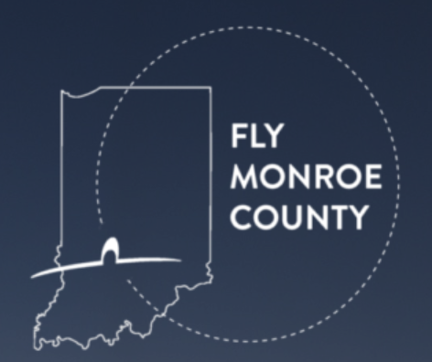
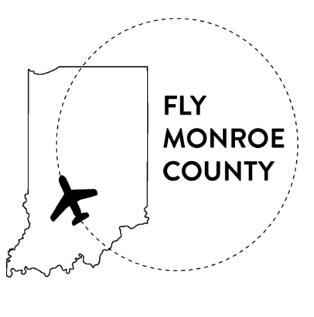
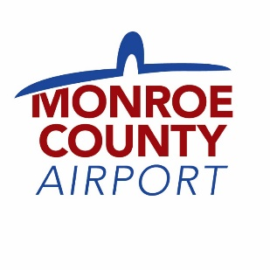
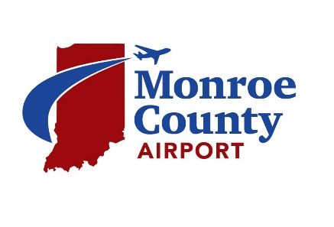
Logos – Initial thoughts? Is it a problem that Bloomington isn’t in the name? Is it important to have the state in the logo?
Lots of states have a Monroe County so it must be more than that
If you are going to use Monroe County, then you must have the state in there
A dash line has a navigational connotation and this one is going in a circle – means your lost
Its BMG – call it that and put BMG on a state
Change the name to Monroe Regional Airport - makes it more descriptive
Change name to Hoosier Upland Regional Airport
Use “Regional”
Don’t get too hung up on BMG
Go totally out of the box on the name
Call it Keister Field – KBMG then say Bloomington, IN
Bill it as a corporate airport not a regional airport
Be a regional hub
Red and blue together reminds me of politics
Fly Monroe County is not good
Responses

Slide 18
Any last thoughts?
Need a community outreach person
In person events are the best way to get the word out
Join all the regional economic development offices and every chamber of commerce
Make a Technology Center or a hub for innovation like The Mill – maybe Crane would be interested
I like the Food Rave idea – maybe a popup and you can watch airplanes
Not sure how airport relates to the CDO process – do they know?
Airport could be used for shipping – Cook products
Don’t talk about “unexpected” use “surprising” instead – not so negative
Shine it up – looks like old pole buildings
Renovate Carlos’ office - make it nice so it seems like a modern, professional regional facility
Have Carlos’ team become the interface for customer service
Light it up – create a spectator platform
Develop a set of plans for what can be built there
Make it more upscale
Feels like they are waiting for someone to bring an idea to them, instead of them going out after it
Have the BEDC meeting and/or Chamber Board Meeting out there
Responses

Slide 19
Any last thoughts?
Bring Customs there
Do wedding receptions in hangers
Offer “Learn to Fly” seminars
Have a social media – quick here’s what’s happening today
Business after hours
Do liability issues limit community events?
Clemson airport has a student club – why can’t IU?
Need a better town/gown connection
Make it have energy and be vibrant
Creative engagement like art shows, food shows
Ellettsville Church needed a place to meet – find more like that
Outdoor spaces are a huge commodity – even with bad weather you can use a hanger
Build a regional network - Can you do a board seat swap with another county?
Can a technology person get on the board?
Add a drone park
The airport could partner to fly in potential prospects for development
Responses

Slide 20
Any last thoughts?
Connect with the ASE for STEM – kids' interaction in aviation may help growth, make scholarships available
Cleveland airport has a women’s aviation club that partners with history center
Wright Patterson Airforce base
Glad they are thinking this way even if it is a little lofty
Airshows should be a yearly occurrence
Drone demonstrations
Discover Flight – partner with ASE
Responses

Slide 21
To be the regional hub for aviation business activity, economic growth, and a gateway to southern Indiana’s infrastructural future.
1.
2.
To be the regional hub for aviation business activity, and a gateway for economic growth.
3.
To be a valuable partner in untapping the economic potential of our regional Indiana communities.
Vision Statement

Slide 22
To contribute and generate economic benefit to the community and region by providing uncompromised safety, exceptional quality and unparallel customer service in an environment that not only services our aviation community, but equally fosters collaborative partnerships with local leaders and business organization to create an environment where all the community feels welcome and recognizes opportunity.
1.
To contribute economic benefit by providing uncompromised safety, exceptional facilities and unparallel customer experience all in a location that services the aviation community and fosters collaborative partnerships within the region, so all feel welcome and encouraged to grow.
2.
To provide an exceptional airport experience with a focus on people, service, general aviation, and collaborative partnerships that contribute to economic growth.
3.
Mission Statement

Slide 23
Conscientious
Our customers and partners count on us.
Our diligence and persistence in maintaining the highest standards of safety, and service ensure them we are serious in meeting their expectations.
Trustworthy
We take your confidentiality seriously and demonstrate a dependability that encourages long-term relationships.
Be More
Do more than they ask.
Offer more than they know.
Be more than they expect.
Execute Smart
Make it easy for people to do business with us. Create the tools that provide the answers, inspire the dreams and deliver the promise.
Values Statements

Slide 24
In challenging the status quo for regional airports
Exploring unique and innovative opportunities that are consistent our region
Delivering the promise of thoughtful, conscientious reliability to our community
What Our Organization Believes In

Slide 25
Outgoing staff who are happy to serve
Engaged tenants
Strong infrastructure within the facility
Leading edge amenities
A very good reputation to those that know us
Large amounts of land to develop
FAA rules that provide connection
A board that owns the land, instead of the county
Company Strengths

Slide 26
Community members who don’t know an airport exists
Some disengaged tenants
A limited reputation or awareness on who we are and what we offer
Non-existent marketing
An abundance of undeveloped land that giving the impressing it can’t be developed because of political or regulatory reasons
Location by many is considered on the “fringe” with limited traffic
Company Weaknesses

Slide 27
Non-aviation businesses utilizing land near MCA and creating traffic and interest
Large national businesses looking for easy to access, competitively priced land
Clean energy becoming more desired – giving new growth opportunities
Developers looking for land to meet client needs
Organic westside growth
Independent pilots and companies looking for airports easy to use
Market Opportunities

Slide 28
County zero-growth tendencies
County ability to control funds for marketing/improvements/development
Lack of interest on “fringe” portion of county from developers
Westside housing encroachment
Competitive regional airports that have more money, tools and support
Waning public interest in aviation
Market Threats

Slide 29
Shape the narrative on the airport’s story
Target key audiences through increased touch-points with the goal of strengthening relationships
Create a Developer’s Tool Kit
Target messaging to elevate the reputation and successes of the airport
Clear and easy to understand branding and messaging on who and what the airport has to offer
Communication plan that utilizes social media, new website and a series of event opportunities
Expand the “faces” of the airport to assist in relationship building
Company Needs

Slide 30
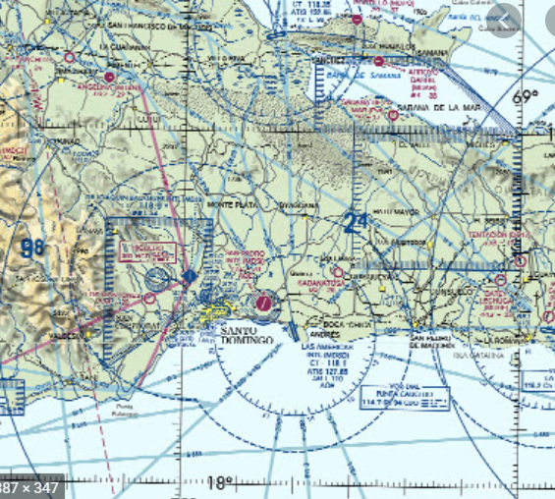
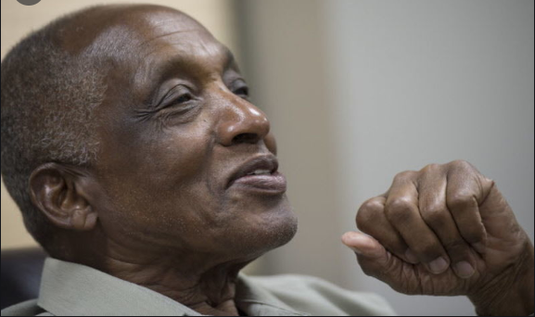
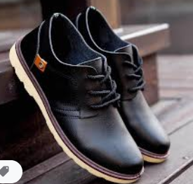
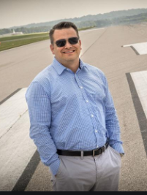
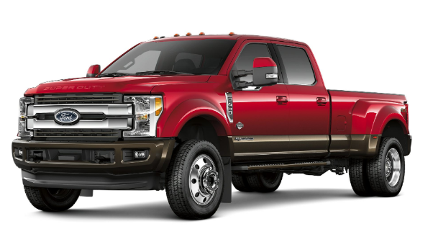
We’re More Than You Expect. We’ve heard it before…small airport, no commercial service, what’s the point. But then you meet us… You receive hospitality at its finest, and safety at its highest. You access technology comparable to the big boys. And you use facilities that make you say, “I like this!” You see, we don’t believe in the status quo. We don’t believe that just because you’re small doesn’t mean you can’t be cutting edge. With us, you find a place that has a casual vibe, but means business. A place where your business can start small and grow big. A place where convenience, location and flexibility are natural. We invite you to look around, ask us anything, and meet the people who will always have your back. Because in the end, just because you didn’t expect it, doesn’t mean it isn’t here.
Brand Personality

Slide 31
Primary
Regional Developers
Regional Business Organizations
Regional Commercial Realtors
Secondary
General Public
Crane
Current Tenants
Tertiary
Corporate Aviation
Pilot Organizations
Audiences

Slide 32
MCA is an untapped economic opportunity looking for partners.
MCA Board Leadership is supportive and encourages creative development ideas
MCA facilities are perfect for clean energy and technology driven entrepreneurs
Community leaders see MCA as a willing partner in economic development efforts
MCA’s priority and reputation as a safety leader makes them a valued location for sensitive
commercial and military development
How We Talk About Ourselves

Slide 33
Success Equals
MCA’s ability to increase awareness of their services and location as a development option
Customers Choose MCA
Because we make doing business easy
MCA’s Unique Selling Proposition
Our facilities and location offer creative business opportunities for economic advancement
Key Outcomes

Slide 34
When People Encounter MCA, They Feel
Secure in its abilities
MCA’s Two Most Important Values
Trustworthy
Execute Smart
The Core Character of MCA
Be more than they expect

Slide 35
To Our Community
MCA provides a location where opportunity and business creativity are encouraged, supported and given the tools to thrive so they can enrich the economic vitality of the region.
Positioning Statement

Slide 36
PAYOFF
Enriched economic vitality for the region
EMOTIONAL
Brand Elements constant throughout the company
PERSONALITY
PLEDGE
We don’t believe in the status quo
A Trusted partner that is easy to do business with
More Than
You Expect
PROOF
Instant Landing System 2016 Airport of the Year
24/7 All Weather
Pilot Controlled Lighting
Financially Self Sufficient Highly Satisfied Tenants
Exceptional Safety Record
Consistent Leadership
FUNCTIONAL
Brand Elements customized by each individual entity
POSITIONING
MCA provides a location where opportunity and business creativity are encouraged, supported and given the tools to thrive so they can enrich the economic vitality of the region.
MISSION
To provide an exceptional airport experience with a focus on people, service, general aviation and collaborative partnerships that contribute to the regional economy.
Brand Platform

Slide 37
Vibe
Direct, clean, timeless yet with a spark of energy
Font Considerations
Benton Sans Condensed
Colors
Jean
#33658A
Dusk
#002C54
Golden
#EFB509
Bronze
#CD7213
Logo Look And Vibe

Slide 38
Logo Ideas

Slide 39
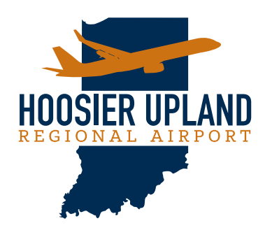
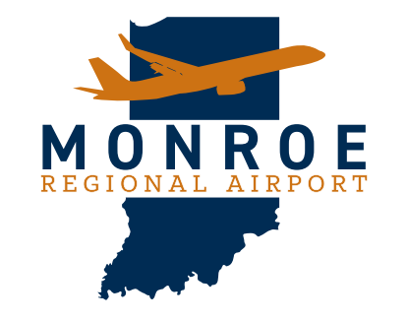
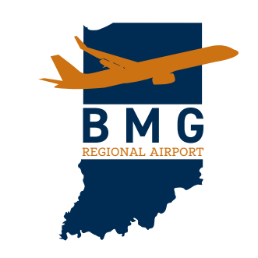
Logo Ideas

Slide 40
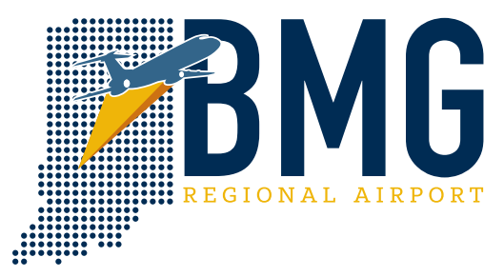
Logo Ideas

Slide 41
What Is Our Approach
We Bring Our “A” Game. Turns out when you what to succeed in today’s environment YOU must be the competitive advantage. The asset. The differentiator. We’re all that and more, because having a competitive advantage doesn’t dependent on an organization’s ability to produce differentiated products or services, but instead, how they engage, and interact with their customers, and are the best partner possible. Strong partnerships lead to creative thinking. Creative thinking leads to innovation. Innovation leads to growth. When we partner – we bring our “A” game.
Who Are We
We’re A Trusted Partner. When you grow, we want to grow with you. That’s right, we’re not just a location that offers a place to park your plane. We’re looking for big thinkers, big dreamers. Someone who sees opportunity in our wide-open expanse. Because in our vision, we’re the regional hub for aviation business activity, and a gateway to an infrastructure that is expanding and changing for the better in economic growth. We specialize in trusted partnerships. Because in our world, safety is first, and that doesn’t happen without unrelenting trust. So, let’s partner together, build your business and see how high we can fly.
Communication Platform

Slide 42
What Is Our Character
We’re Low-Key, High-Support. We’re not one to boast. In fact, you might hardly notice we’re here. But don’t let our low-key presence take away from our high-level of support. A support that makes a difference when telling our region’s story. A support that prides itself in creating an environment that not only services our aviation community, but equally fosters collaborative partnerships with local business to create an environment where all feel welcome and a sense of place.
Why Do We Matter Now
We’re A Contributor. We know we have value. Our contribution to the intricate transportation infrastructure of the region makes us ripe for being a player in the future of economic growth. Our culture, our leadership, and our assets are well positioned for the next generation of clean energy, environmental creations, and technology innovation. If you’re looking for a leader, look no further.
Communication Platform

Slide 43
What is our Approach
We Bring Our “A” Game
Who Are We
We’re A Trusted Partner
We’re More Than You Expect. We’ve heard it before…small airport, no commercial service, what’s the point. But then you meet us… You receive hospitality at its finest, and safety at its highest. You access technology comparable to the big boys. And you use facilities that make you say, “I like this!” You see we don’t believe in the status quo. We don’t believe that just because you’re small doesn’t mean you can’t be cutting edge. With us, you find a place that has a casual vibe, but means business. A place where your business can start small and grow big. A place where convenience, location and flexibility are natural. We invite you to look around, ask us anything and meet the people who will always have your back. Because in the end, just because you didn’t expect it, doesn’t mean it isn’t here.
What Is Our Character
We’re Low Key, High Support
Why Do We Matter
We’re A Contributor
Communication Platform

